Slide 1
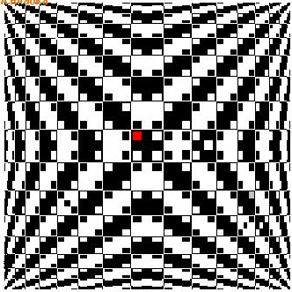

13 difference

Slide 2
funny puzzle
Book
Friend
School
Class
Lesson
Student
Director
Merit
Teacher
a | J | l | n | g | l | d | d | Z | Z
W | i | L | o | S | k | I | p | b | T
T | B | Q | S | O | D | R | G | E | T
B | O | U | S | N | H | E | A | B | S
O | W | U | E | T | W | C | X | G | S
O | E | I | L | M | H | T | S | T | T
K | R | N | V | E | E | O | P | Z | N
F | A | Q | R | E | G | R | E | N | W
T | N | E | D | U | T | S | I | L | C
c | L | a | S | s | N | v | D | T | s

